Slide 1
International Shipping Status in PowerBI
By Bruno Tortola
https://www.linkedin.com/in/brunotortola/
brunohtortola@gmail.com

Slide 2



International Shipping Status
This presentation is going to show the development of a PowerBI dashboard to control the status of international shipment of automotive parts by air and by sea.
The main goal is to visualize which parts of the process are better performing, as well as from which country and/or delivery company.

Slide 3
International Shipping
Parts can travel either by sea or by air.
For each, there are different schedules and time limits it must follow, in order to be considered an “OK” process.
However, if the shipment total time is above the contractual time, that process did not perform.
We wanted to see in which part of the process the delays where, so we could tackle them directly

Slide 4
Goals of the Dashboard
Have a bird’s eye view of the air and maritime shippment flow.
Separate the flow into its parts, from the boarding process to the customs at the destination
Visualize the times in which the process performed, and comparte that to the contractual times.
Identify, then, which parts of the process were not performing, and tackle the problems within.

Slide 5
Technologies used
Power BI
Excel
Sharepoint
Power Automate Web
DAX
M
Power Query

Slide 6
Disclaimers
In order to preserve critical information of the company, some data had to be blanked out.
For the same reason, the original .pbix file cannot be shared, so I’m presenting it in PowerPoint format instead.

Slide 7
Dashboards and Charts

Slide 8
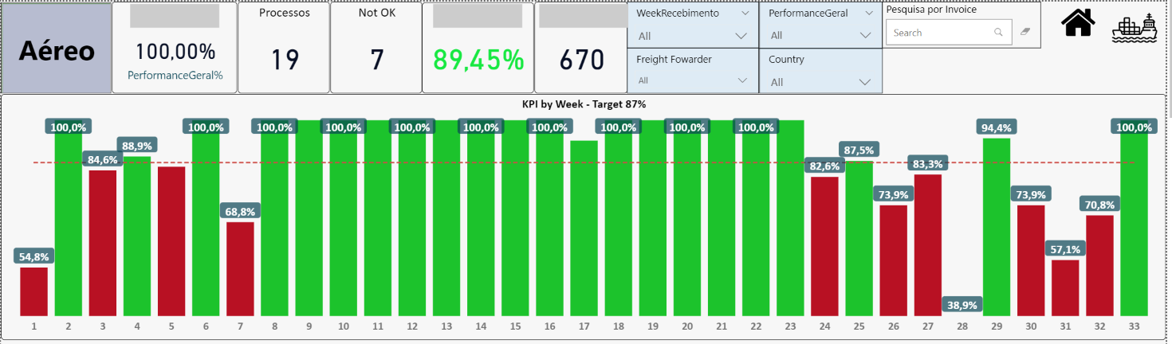
Overview
This section of the KPIs show the main values we control for the air flow. The amount of process, the “not ok” amount, the main filters, and a bar chart showing the evolution of the performance in a weekly basis.

Slide 9
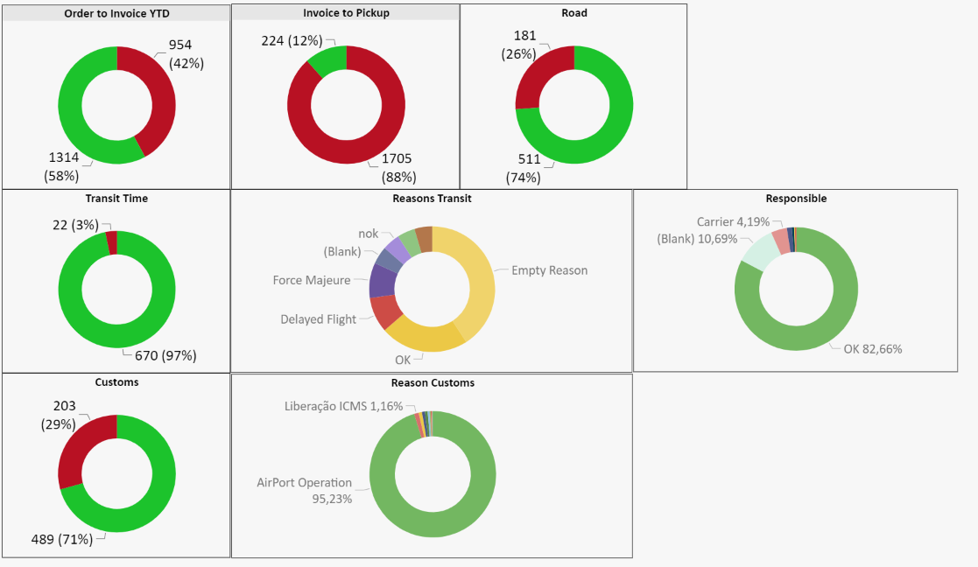
Performance by process
The shipment flow involves 5 different processes, and each is shown below in an “donut” chart showing the % of it that performed. Note that for the processes “Transit Time” and “Customs” we have further charts detailing the reasons supplied by the freight fowarders for why a process did not perform.

Slide 10
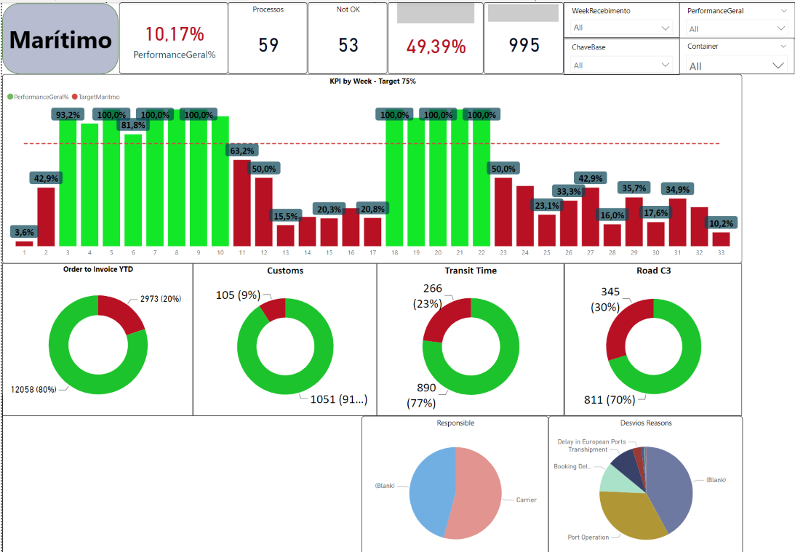
Maritime flow
And below is the same data, but for the maritime flow, that has different contracted time due to the nature of the sea shipment process

Slide 11
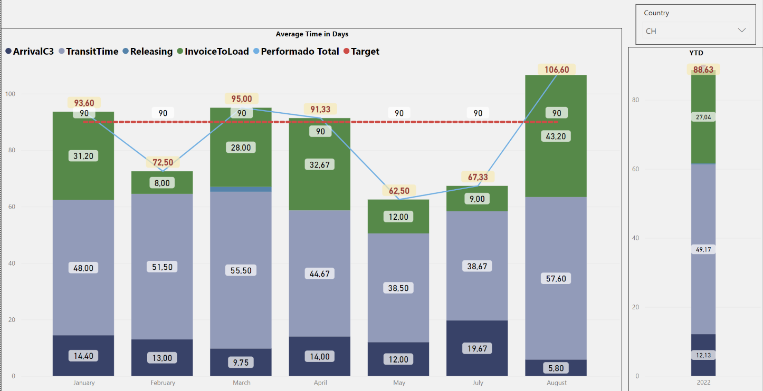
Lead time by days average
This bar chart shows, by month, the average time in days that each process performed. There is also a filter for the country, and a moving average bar that changes accordingly. Also on the right is the YTD chart.

Slide 12
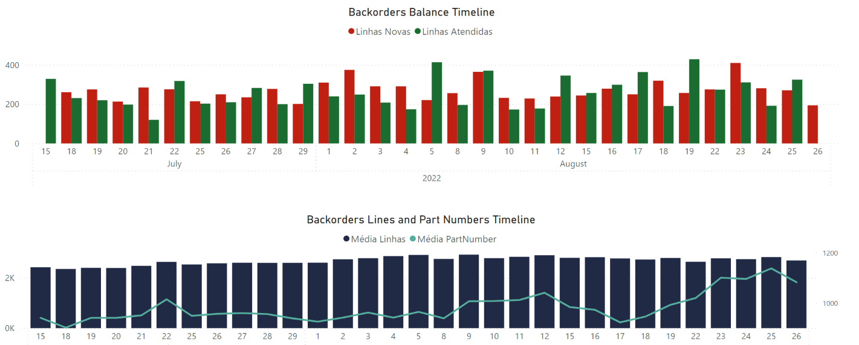
Timeline charts
The bar chart on the top shows in green the amount of lines that were fulfilled, and in red the new ones, from a daily point of view.
The chart on the bottom shows the average amount of lines on the bars and part numbers on the lines.

Slide 13
Schema and Datasets

Slide 14
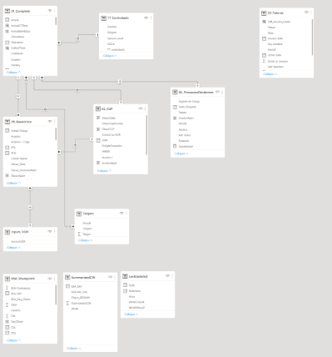
Datasets
This dashboards uses 7 connected dashboards plus 4 auxiliary ones, to get all the data we needed.
The complexity of this dataset is to always connect the data using an unique key, with two values from the shipment process, invoice number and a freight fowared identifier

Slide 15
DAX

Slide 16
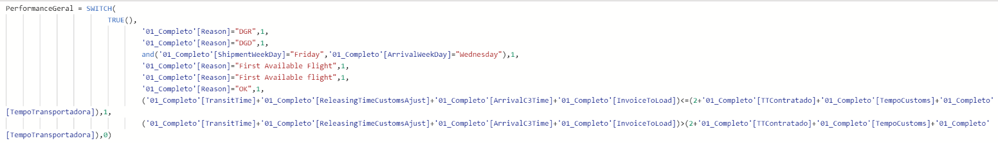
DAX
This was a very DAX intensive project, since we only had the raw data ready, and all the calculations for targets, amount in days and many other had to be developed
It was also intensive for the stake holders, since they were the ones who knew about the process. So we worked together to bring the knowledge of the process to the dashboard format.

Slide 17
Power Query

Slide 18
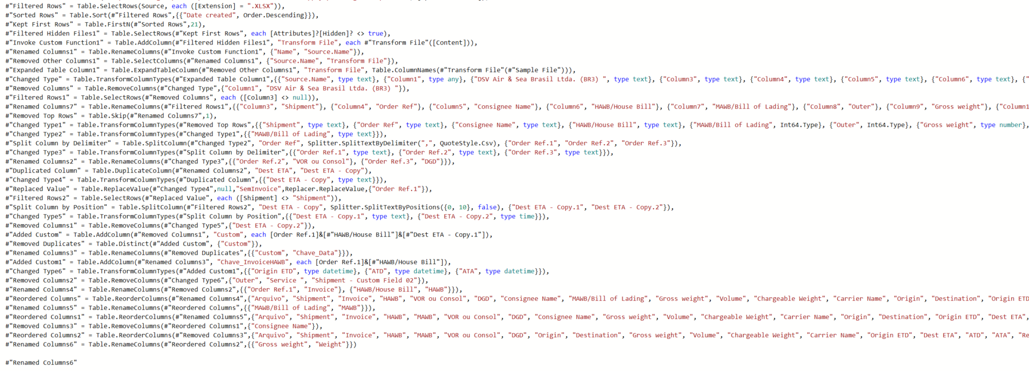
Power Query
Power Query is a pre-load process that we can apply to datasets in order to import data and clean it up before actually loading to PowerBI and start making charts.
This project was also very Power Query intensive, since the raw data from the freight fowarders needed to be heavily worked upon to be useful

Slide 19
Power Automate

Slide 20
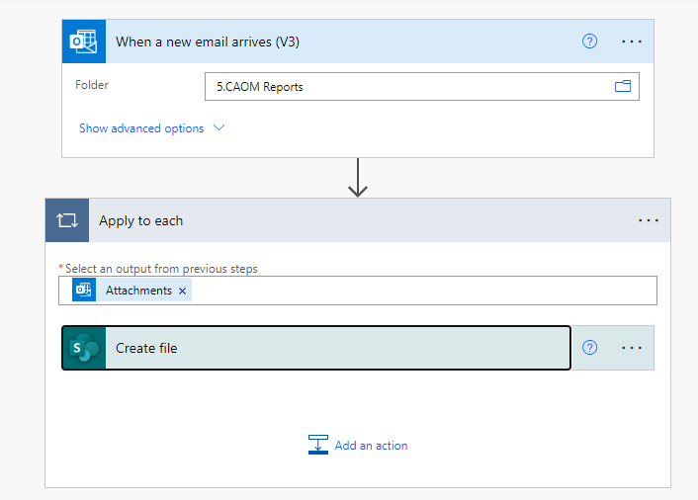
Power Automate Web
There are 2 flows for this project, since we have two different freight fowarders that sent us a daily report.
The files arrive by email in a shared email. Then an outlook rule sent them to my company email, and Power Automate takes the attachment and save it to sharepoint, so the PowerBI can connect to it

Slide 21
Automated Refresh and Reports

Slide 22
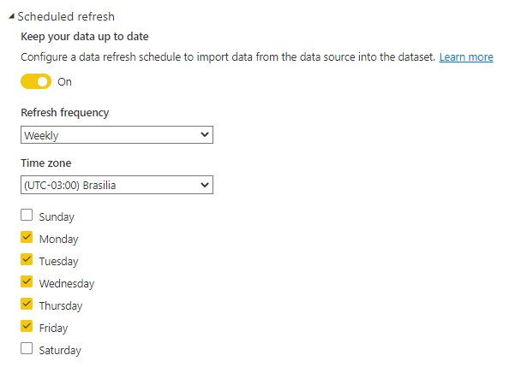
Automated Refresh
The dataset is refreshed daily on weekdays, and published to the Power BI online services. This updates all of the datasets and makes the latest version available for the stakeholders, all done automatically

Slide 23
Thanks for checking out my work!
Lets connect on LinkedIn!
https://www.linkedin.com/in/brunotortola/
brunohtortola@gmail.com

